Slide 1


Mobile Phone Security
Dr. Digvijaysinh Rathod
Associate Professor & Associate Dean
School of Cyber Security and Digital Forensics
National Forensic Sciences University with status of Institution of National Importance
digvijay.rathod@gfsu.edu.in

Slide 2
InsecureBankv2
InsecureBankv2 – Vulnerable Android Application
Dr. Digvijaysinh Rathod

Slide 3
InsecureBankv2
https://github.com/dineshshetty/Android-InsecureBankv2
This vulnerable Android application is made for security enthusiasts and developers to learn the Android insecurities by testing this vulnerable application
Its back-end server component is written in python.
It is compatible with Python2
Dr. Digvijaysinh Rathod

Slide 4
InsecureBankv2
The list of vulnerabilities that are currently included in this release are:
Flawed Broadcast Receivers
Intent Sniffing and Injection
Weak Authorization mechanism
Local Encryption issues
Vulnerable Activity Components
Root Detection and Bypass
Emulator Detection and Bypass
Insecure Content Provider access
Insecure Webview implementation
Weak Cryptography implementation
Dr. Digvijaysinh Rathod

Slide 5
InsecureBankv2
The list of vulnerabilities that are currently included in this release are:
Application Patching
Sensitive Information in Memory
Insecure Logging mechanism
Android Pasteboard vulnerability
Application Debuggable
Android keyboard cache issues
Android Backup vulnerability
Runtime Manipulation
Insecure SDCard storage
Insecure HTTP connections
Parameter Manipulation
Dr. Digvijaysinh Rathod

Slide 6
InsecureBankv2
The list of vulnerabilities that are currently included in this release are:
Hardcoded secrets
Username Enumeration issue
Developer Backdoors
Weak change password implementation
Dr. Digvijaysinh Rathod

Slide 7
InsecureBankv2
Installation steps
Download the zip file from : https://github.com/dineshshetty/Android-InsecureBankv2.
Unzip it.
Find the apk InsecureBankv2.apk and install
adb connect ip-address (avd - Genymotion)
adb devicecs (This shows that ip address)
Dr. Digvijaysinh Rathod

Slide 8
InsecureBankv2
Installation steps
If you don't find ip address or if you finds message like “unable to connect” using adb then check then check
Adapter settings of the virtual box is NAT or not. If it is Bridge Network then change to NAT.
But if you want to run the server in the santoku and would like to connect android app running in the Genymotion then set the adapter of the santoku to Bridge adapter.
Dr. Digvijaysinh Rathod

Slide 9
InsecureBankv2
Installation steps
Simply if you wants to connect santoku using adb with Genymotion used set adapter of santoku to “NAT”
If you the server is running in the santoku and would like to connect android application running in the Genymotion then set adapter as “Bridge Adapter”
Dr. Digvijaysinh Rathod

Slide 10
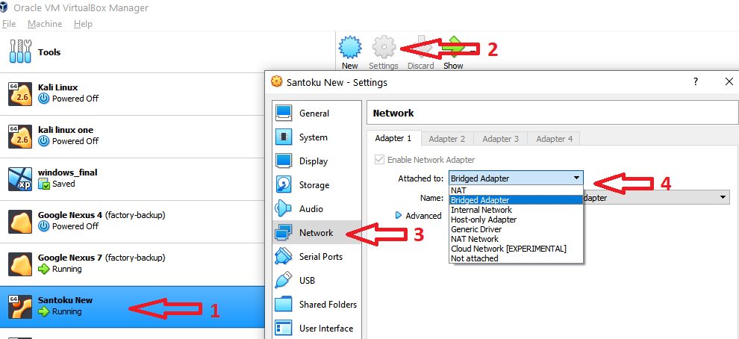
InsecureBankv2
How to access the adapter option of santoku ?
Dr. Digvijaysinh Rathod

Slide 11
InsecureBankv2
Installation steps
README.markdown – for installation steps
adb install InsecureBankv2.apk
Move to santoku folder where you have downloaded the InsecureBank2 code.
cd AndroLabServer
You will find requirements.txt which has configuration files to configure dependences
Dr. Digvijaysinh Rathod

Slide 12
InsecureBankv2
Installation steps
Check the version of python: python –V (it has to be >= 2.0 < 3.0) because this application is developed using python 2.7.0
python apt install python-pip
Check the version of pip also: pip –V
Or you can try sudo apt install python-pip
Now you can install the dependences from requirements.txt files
Dr. Digvijaysinh Rathod

Slide 13
InsecureBankv2
Installation steps
sudo python –m pip install –r requirements.txt
If you want you can open the requirement.txt file and also can install individual components
Dr. Digvijaysinh Rathod

Slide 14
InsecureBankv2
Installation steps
sudo python –m pip install flask
sudo python –m pip sqlalchemy
sudo python –m pip web.py
sudo python –m pip cherrypie
python app.py
If you find message that requirement already satisfied it means that it is already installed.
To run the server in the santoku
Dr. Digvijaysinh Rathod

Slide 15
InsecureBankv2
Dr. Digvijaysinh Rathod

Slide 16
InsecureBankv2
Installation steps
to run the server in the santoku
python app.py this will show that server started at port 8080.
If it show the error at print statement it means that you are using python version > 2.X. or you have installed dependences using > pip2.X.
If you receive error related to cheroot then try
sudo python –m install cheroot
Dr. Digvijaysinh Rathod

Slide 17
InsecureBankv2
Installation steps
We also tried following commands to resolve the error
sudo apt install python-setuptools
sudo python –m pip install jaraco-functools >=1.20
sudo python –m pip install more-itertools==5.0.0
Once your server started in the santoku
Open the installed InsecureBankv2 application in the Genymotion
Dr. Digvijaysinh Rathod

Slide 18
InsecureBankv2
Installation steps
On the left top corner open setting → preferences → Sever IP (set ip of santoku) and server port (set 8080)
You will receive message connection that connect successful with server
Use the credentials dinesh/Dinesh@123$ or jack/Jack@123$ and start using the application
Dr. Digvijaysinh Rathod

